Slide 1
VIIRS SNPP and J1 DNB LUTs Comparison Yalong Gu¹, Wenhui Wang¹ and Changyong Cao² ¹Earth Resources Technology, Inc. ²NOAA/NESDIS/STAR

Slide 2
Core Equations
Eq. 120 (radiometric calibration ATBD)
Eq. 121 (radiometric calibration ATBD)
LUTs:
DNB Frame to Zone LUT: Aggregaztion
DNB Response verse Frame LUT: RVS
DNB Dn0 PC LUT: offset
DNB LGS Gains PC LUT: gain coefficient for LGS
DNB Gain Ratio PC LUT: gain coefficient for HGS and MGS (transferred from LGS)
2

Slide 3
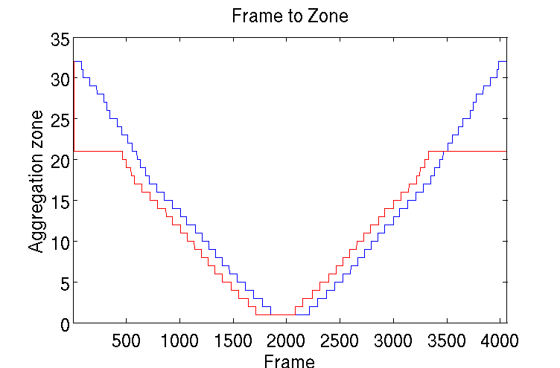
Frame to Zone (Aggregation)
SNPP:
5182ab22-1e236-0a4f180b-5bd35d73.VIIRS-SDR-DNB-FRAME-TO-ZONE-LUT_npp_20020101010000Z_20020101010000Z_ee00000000000000Z_PS-1-D-NPP-1-PE-_devl_dev_all-_all.bin
J1:
VIIRS-SDR-DNB-FRAME-TO-ZONE-LUT_j01_20150724000000Z_20150724000000Z_ee00000000000000Z_PS-v1-Op21-BE-PE-_all-_dev_all-_all.bin
3

Slide 4
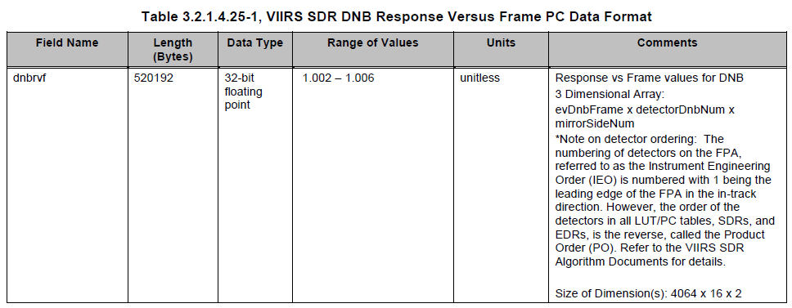
Response vs Frame
SNPP:
5182ab22-30478-0a4f180b-5bd47fb5.VIIRS-SDR-DNB-RVF-LUT_npp_20020101010000Z_20020101010000Z_ee00000000000000Z_PS-1-D-NPP-2-PE-_devl_dev_all-_all.bin
J1:
VIIRS-SDR-DNB-RVF-LUT_j01_20150724000000Z_20150724000000Z_ee00000000000000Z_PS-v1-Op21-BE-PE-_all-_dev_all-_all.bin
4

Slide 5
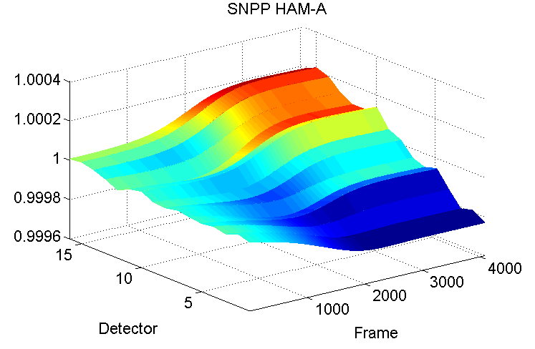
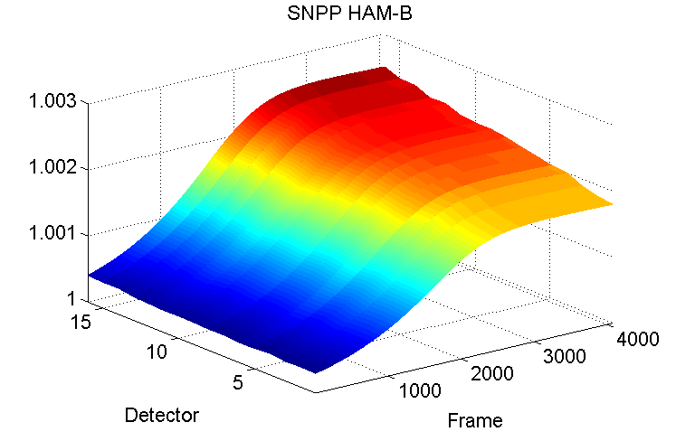
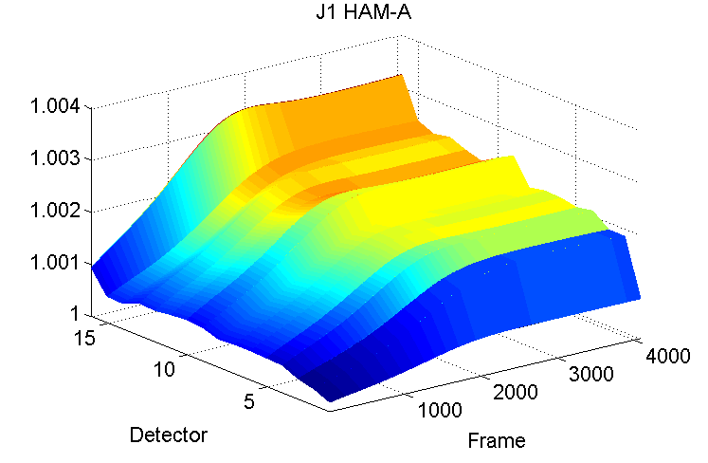
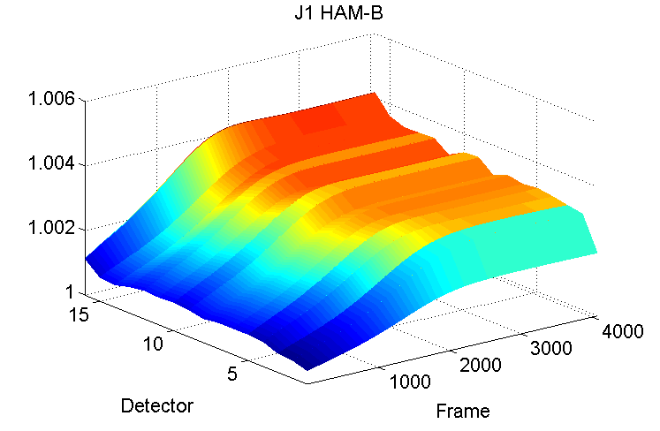
Response vs Frame
SNPP
J1
5

Slide 6
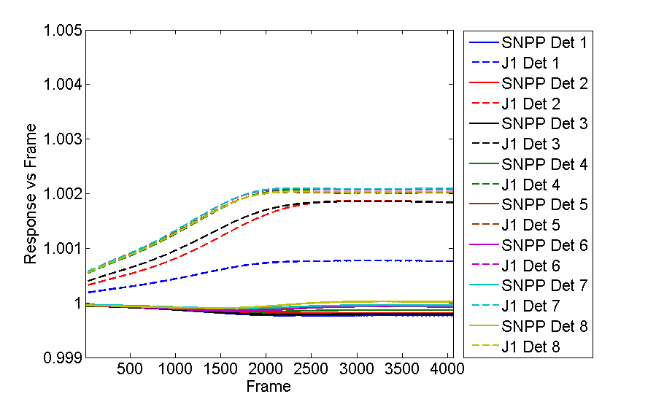
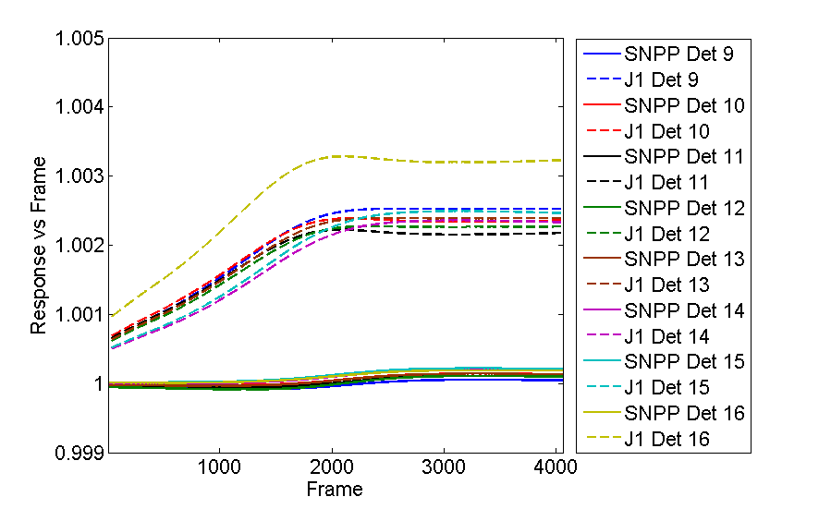
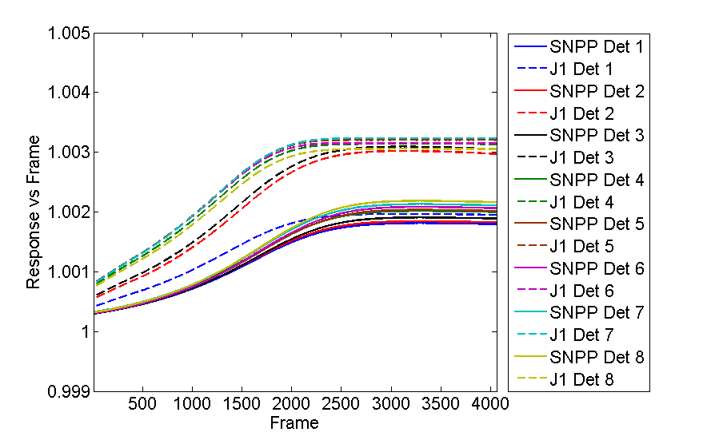
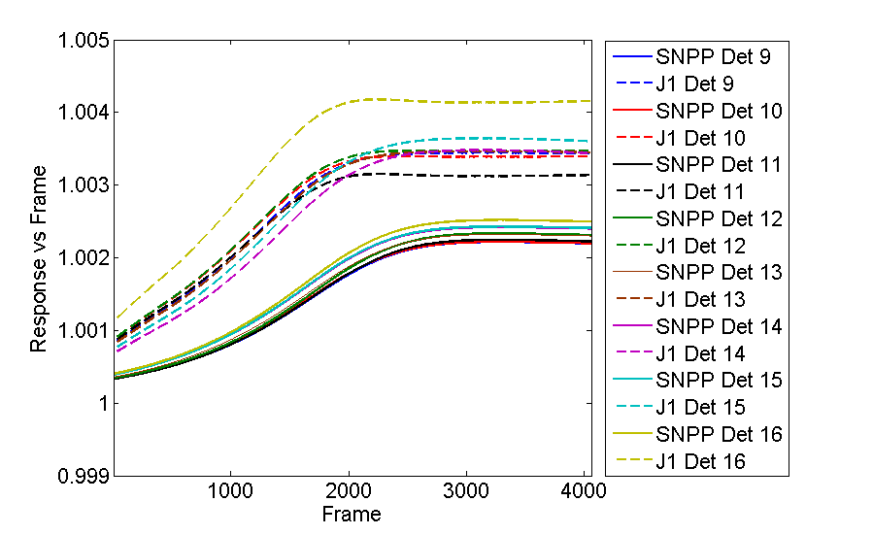
Response vs Frame
HAM-A Dets 1-8
HAM-A Dets 9-16
HAM-B Dets 1-8
HAM-B Dets 9-16
6

Slide 7
Remarks
Observation:
Relatively large variation of J1 RVF among 16 along track detectors
Potential impact:
Stripping patterns in the generated SDR products
7

Slide 8
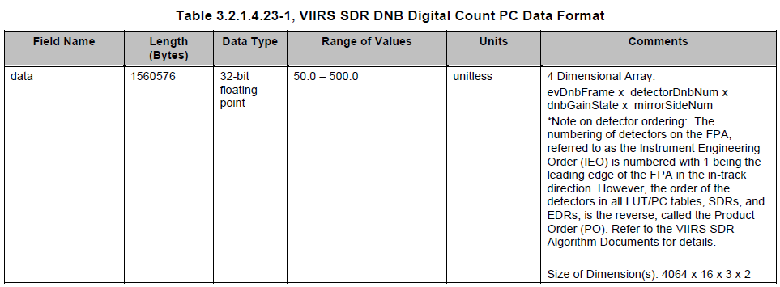
DN0
SNPP:
536d6e81-92b65-6880dc6d-32fff953.VIIRS-SDR-DNB-DN0-LUT_npp_20140429000000Z_20140429000000Z_ee00000000000000Z_PS-1-O-CCR-14-1547-1543-JPSS-DPA-027-PE_noaa_all_all-_all.bin
J1:
VIIRS-SDR-DNB-DN0-LUT_j01_20150724000000Z_20150724000000Z_ee00000000000000Z_PS-v1-BE-PE-_all-_dev_all-_all.bin
8

Slide 9
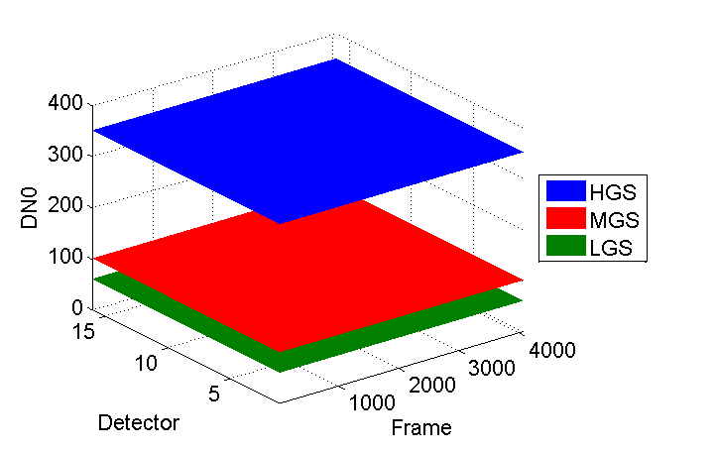
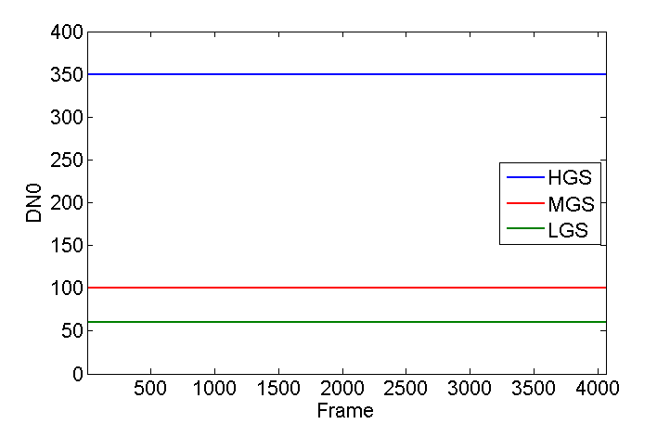
DN0 J1
9

Slide 10
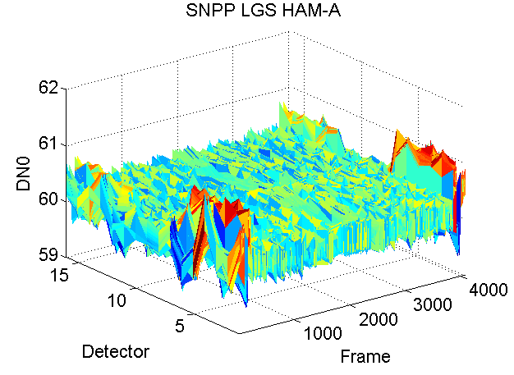
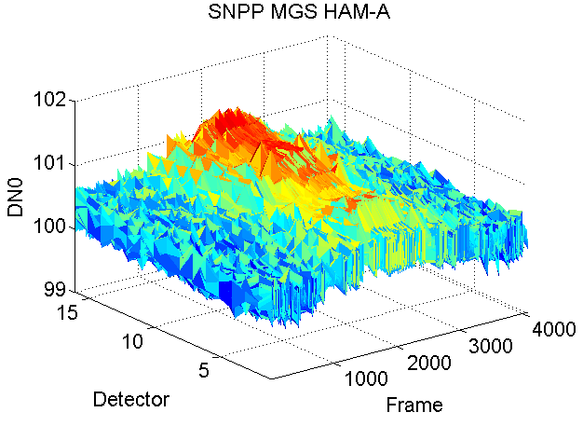
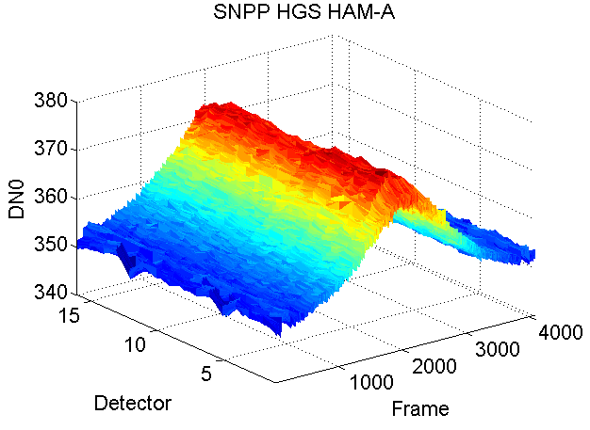
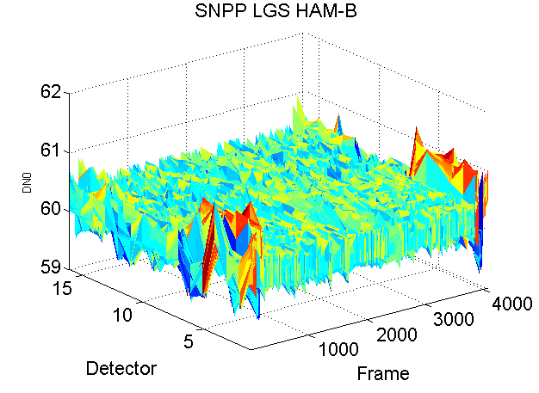
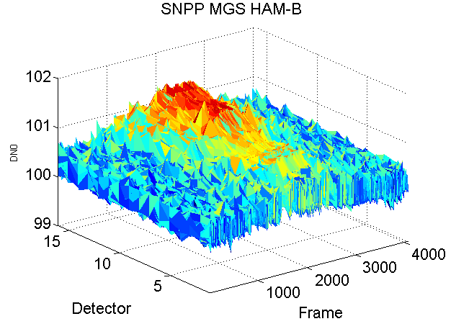
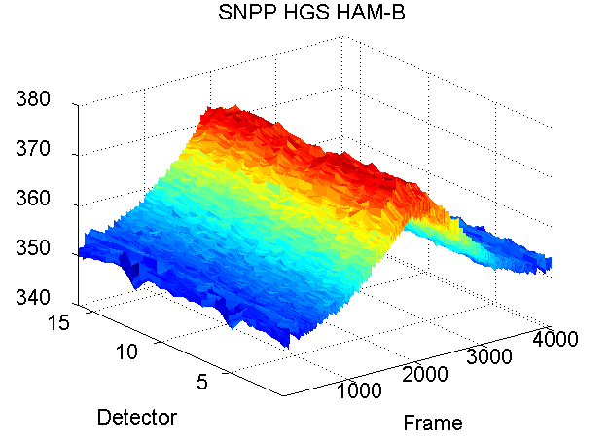
DN0 SNPP
HAM-A
HAM-B
10

Slide 11
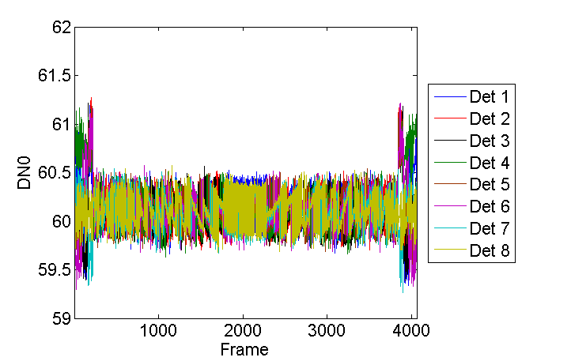
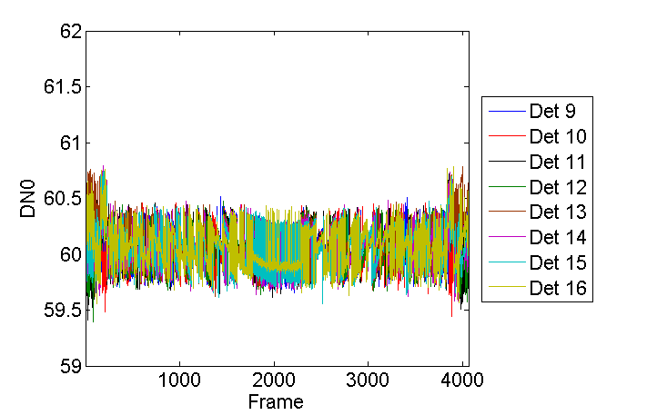
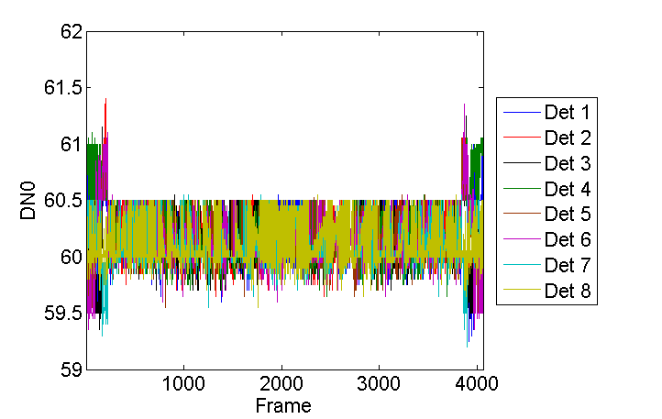
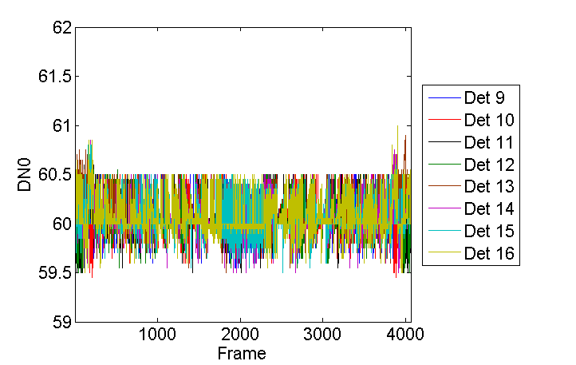
DN0 LGS SNPP
HAM-A Dets 1-8
HAM-A Dets 9-16
HAM-B Dets 1-8
HAM-B Dets 9-16
11

Slide 12
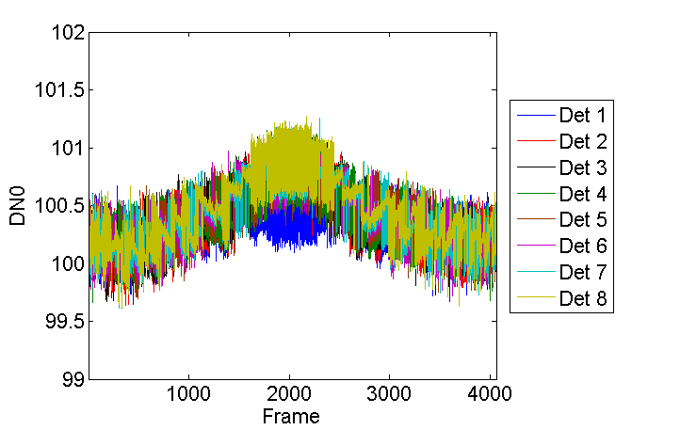
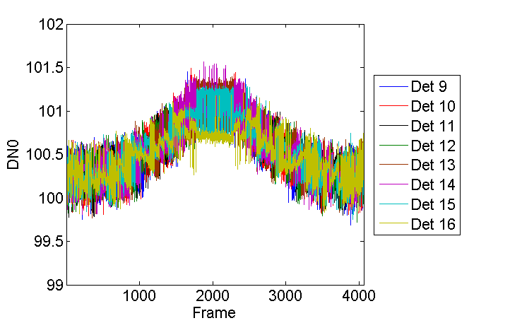
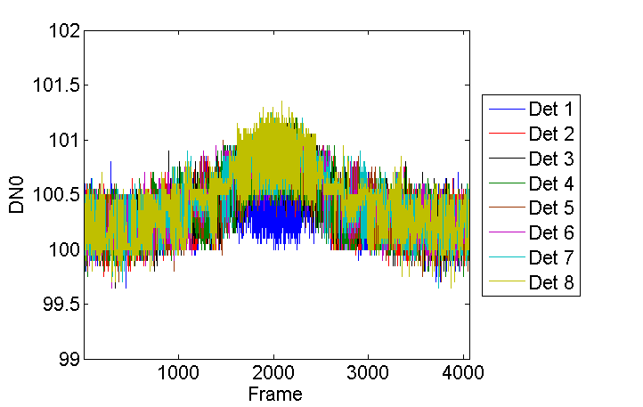
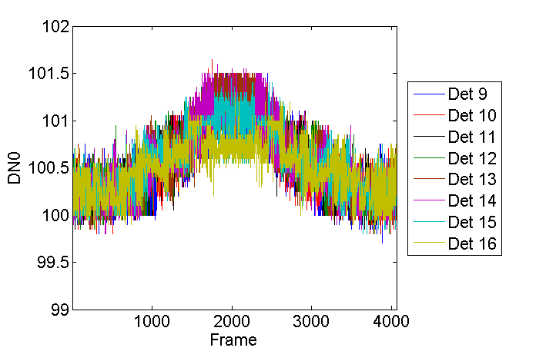
DN0 MGS SNPP
HAM-A Dets 1-8
HAM-A Dets 9-16
HAM-B Dets 1-8
HAM-B Dets 9-16
12

Slide 13
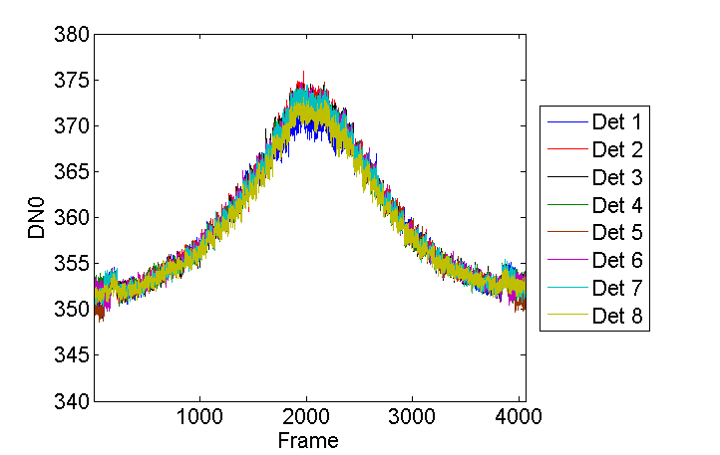
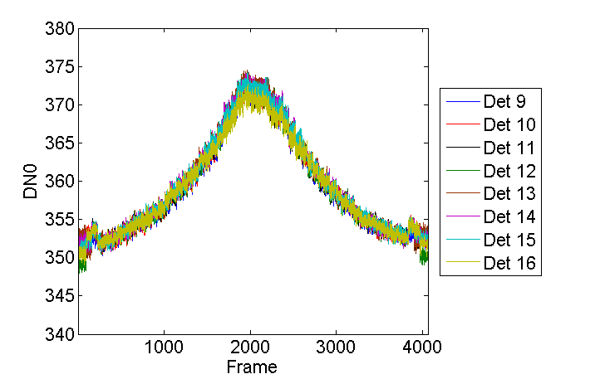
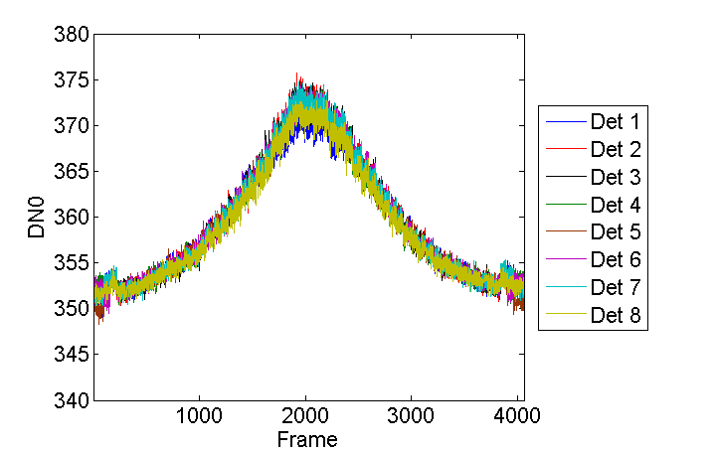
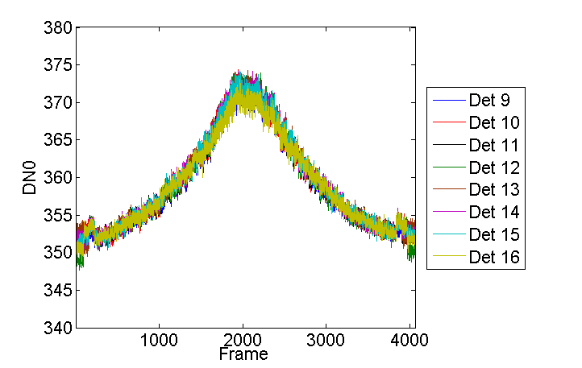
DN0 HGS SNPP
HAM-A Dets 1-8
HAM-A Dets 9-16
HAM-B Dets 1-8
HAM-B Dets 9-16
13

Slide 14
LGS Gains
SNPP:
52d94c3e-1f8ed-a8c0f409-7c8c2614.VIIRS-SDR-DNB-LGS-GAINS-LUT_npp_20140117102700Z_20140123234400Z_ee00000000000000Z_PS-1-0-CCR-13-1473-JPSS-DPA-013-PE_noaa_all_all-_all.bin
J1:
VIIRS-SDR-DNB-LGS-GAINS-LUT_j01_20150724000000Z_20150724000000Z_ee00000000000000Z_PS-v1-BE-PE-_all-_dev_all-_all.bin
For the DNB, the LGS gain is the analog of the F factor for non-DNB bands (Eq. 65, the radiometric calibration ATBD) which rescale all three calibration coefficients (c coefficients). There are two types of fitting. (Radiometric Calibration ATBD Appendix C)
F=F₀+F₁*exp[F₂*(T-T_{REF})] Eq. 145 in radiometric calibration ATBD
F=F₀+F₁*(T-T_{REF})+F₂*(T-T_{REF})² Eq. 146 in radiometric calibration ATBD
The F coefficients are functions of aggregation zone, detector and HAM sides.
Both NPP and J1 use the quadratic fitting Eq. 146
14

Slide 15
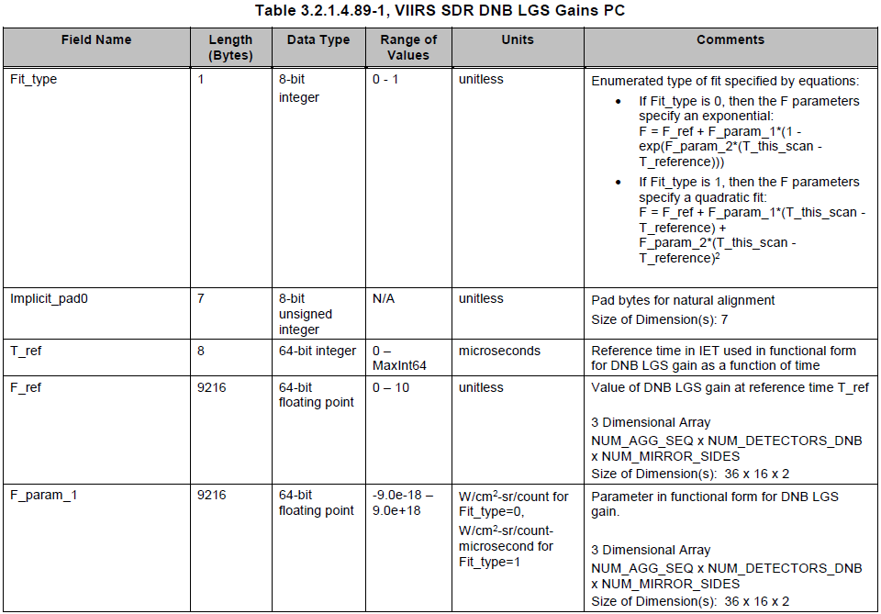
LGS Gains
15

Slide 16
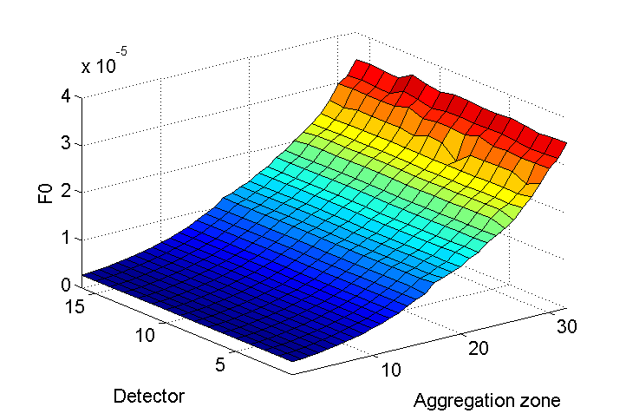
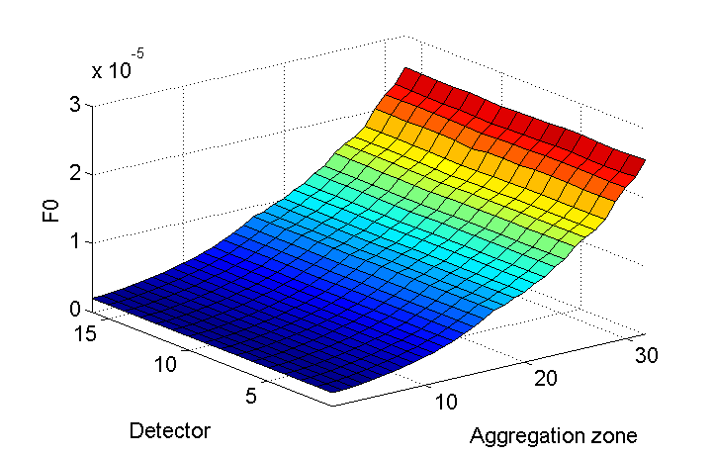
LGS Gains F0 (F_ref)
SNPP HAM-A
SNPP HAM-B
J1 HAM-A
J1 HAM-B
16

Slide 17
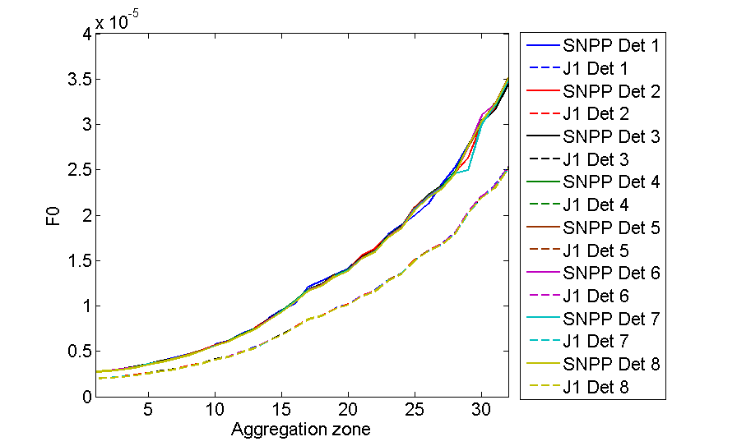
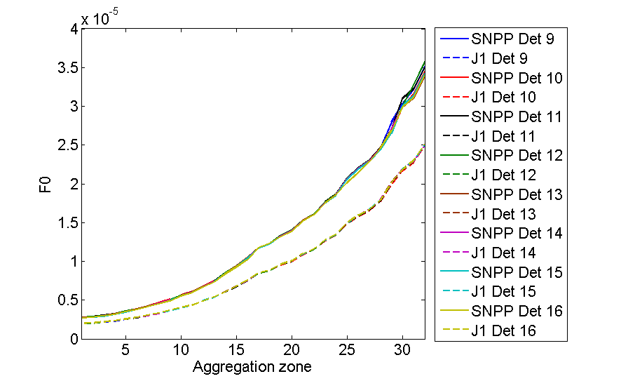
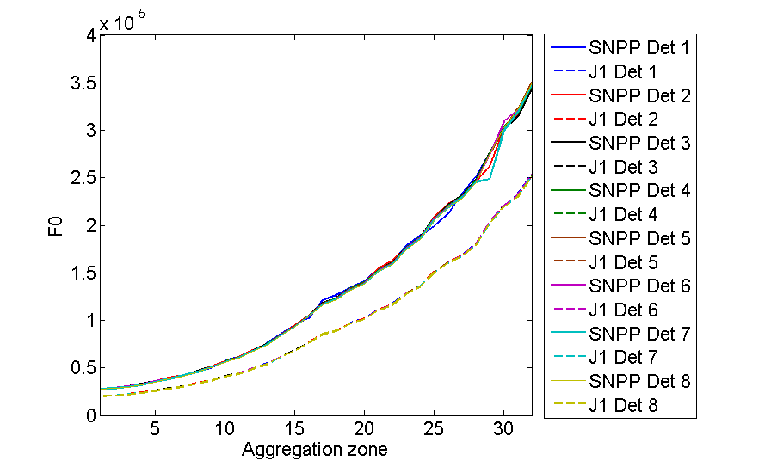
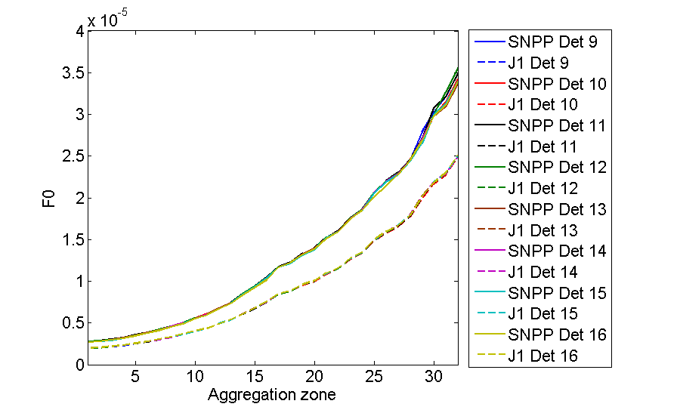
LGS Gains F0 (F_ref) vs Aggregation Zone
HAM-A Dets 1-8
HAM-A Dets 9-16
HAM-B Dets 1-8
HAM-B Dets 9-16
17

Slide 18
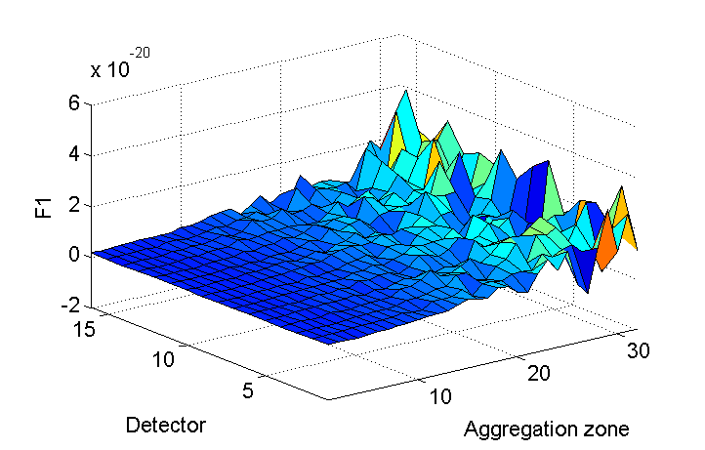
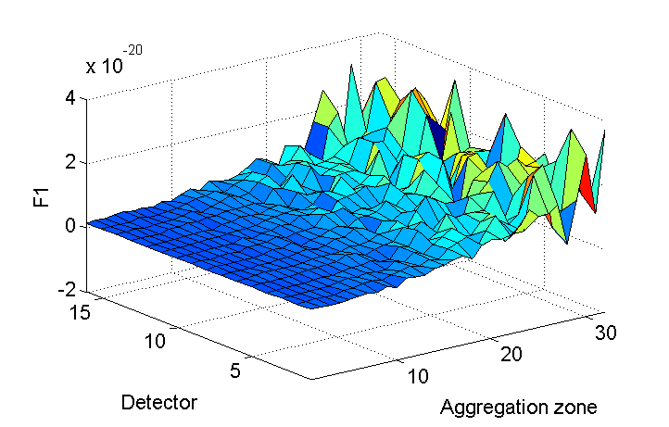
LGS Gains F1 (F_param_1)
SNPP HAM-A
SNPP HAM-B
F1 parameter of J1 is zero.
F2 parameter of both NPP and J1 is zero
SNPP uses linear fitting for its DNB LGS Gains.
Zero F1 and F2 of J1 shows that the temporal variation of J1 LGS Gains (prelaunch) have not been monitored.
18

Slide 19
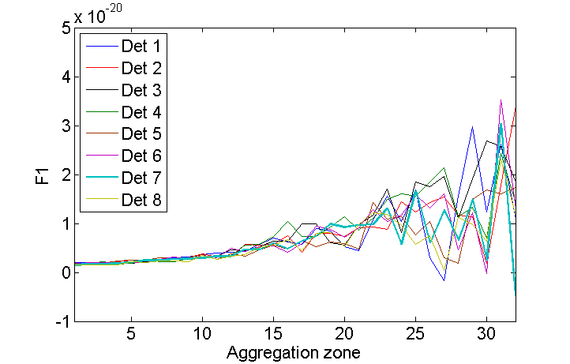
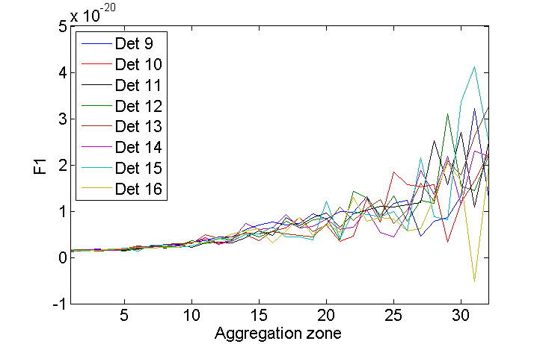
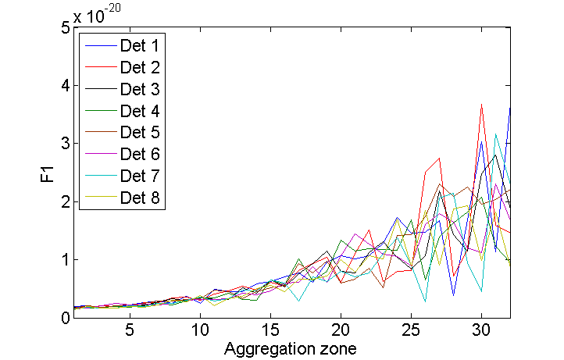
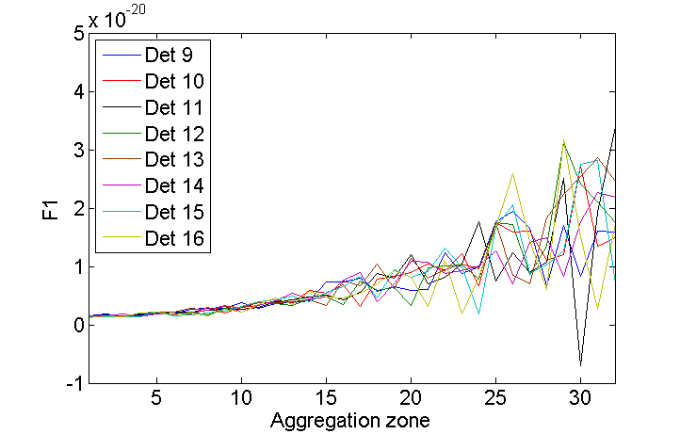
LGS Gains F1 (F_param_1) vs Aggregation Zone
SNPP HAM-A Dets 1-8
SNPP HAM-A Dets 9-16
SNPP HAM-B Dets 1-8
SNPP HAM-B Dets 9-16
19

Slide 20
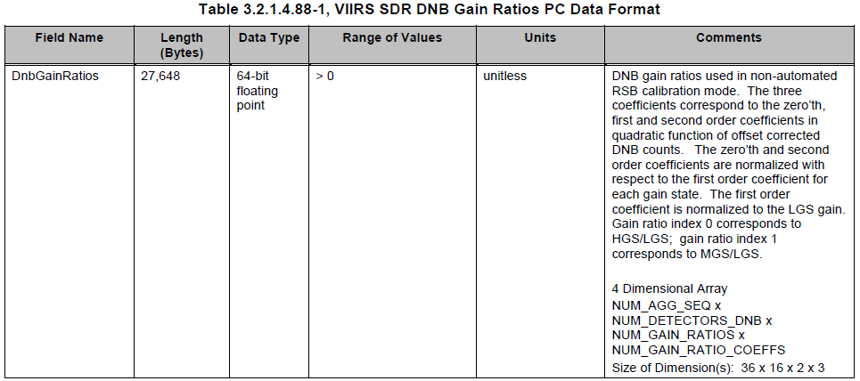
Gain Ratios
SNPP:
539b1609-28ad1-007f0100-8bf6162a.VIIRS-SDR-DNB-GAIN-RATIOS-LUT_npp_20140429000000Z_20140429000000Z_ee00000000000000Z_PS-1-O-CCR-14-1547-JPSS-DPA-007-PE_noaa_all_all-_all.bin
J1:
VIIRS-SDR-DNB-GAIN-RATIOS-LUT_j01_20150724000000Z_20150724000000Z_ee00000000000000Z_PS-v1-BE-PE-_all-_dev_all-_all.bin
20

Slide 21
Gain Ratios
Gain Ratios are the three coefficients (c coefficients) used in quadratic function of the offset corrected DN for MGS and HGS.
For both SNPP and J1, c₀ and c₂ are zero. Their c₁s stored in the LUTs are normalized to the corresponding LGS gains.
The unnormalized c₁ is obtained by multiplying the normalized c₁ by the corresponding LGS gains.
21

Slide 22
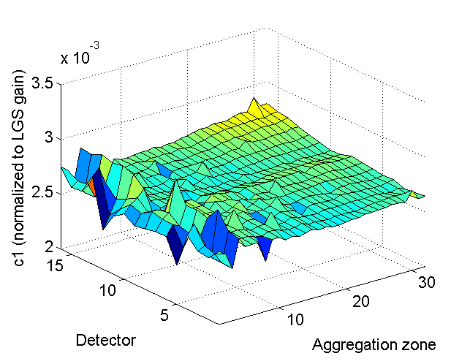
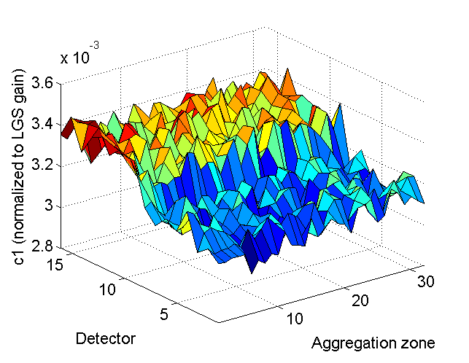
Gain Ratios MGS c₁ (normalized to LGS gain)
J1
SNPP
22

Slide 23
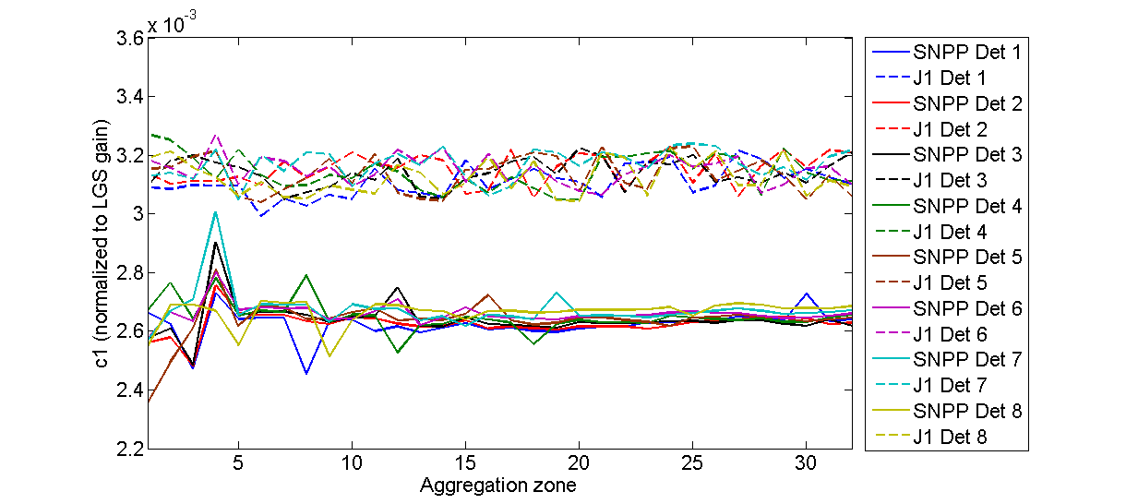
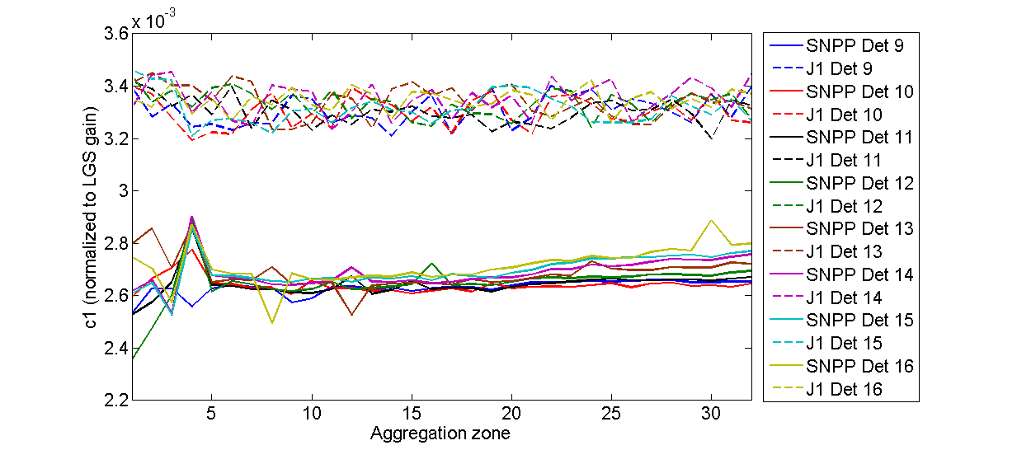
Gain Ratios MGS c₁ (normalized to LGS gain)
Dets 1-8
Dets 9-16
23

Slide 24
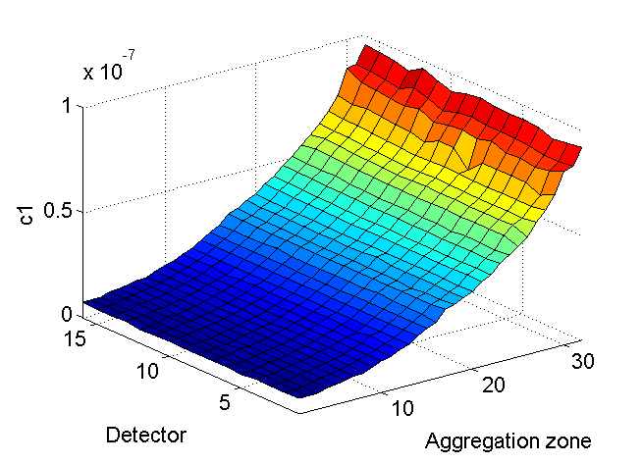
Gain Ratios MGS c₁
J1
SNPP
24

Slide 25
Gain Ratios MGS c₁
Dets 1-8
Dets 9-16
25

Slide 26
Gain Ratios HGS c₁ (normalized to LGS gain)
J1
SNPP
26

Slide 27
Gain Ratios HGS c₁ (normalized to LGS gain)
SNPP Dets 1-8
SNPP Dets 9-16
J1 Dets 1-8
J1 Dets 9-16
27

Slide 28
Gain Ratios HGS c₁
J1
SNPP
28

Slide 29
Gain Ratios HGS c₁
SNPP Dets 1-8
SNPP Dets 9-16
J1 Dets 1-8
J1 Dets 9-16
29
29

Slide 30
Remarks
Gain coefficient (unnormalized) | SNPP (magnitude) | J1 (magnitude)
LGS F_ref | 10⁻⁵ | 10⁻⁵
MGS c₁ | 10⁻⁷ | 10⁻⁷
HGS c₁ | 10⁻¹⁰ | 10⁻⁷
Observation:
J1 HGS c₁ is 3 orders of magnitude higher then SNPP HGS c₁
Potential impact:
DNB SDR products in nighttime
30

